Slide 1

Setting up your
ML application
Train/dev/test
sets
deeplearning.ai

Slide 2
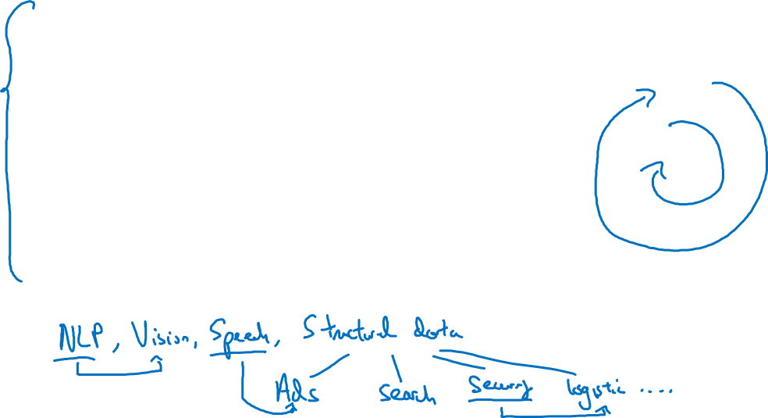

Applied ML is a highly iterative process
# layers
Idea
# hidden units
learning rates
activation functions
…
Experiment
Code

Slide 3
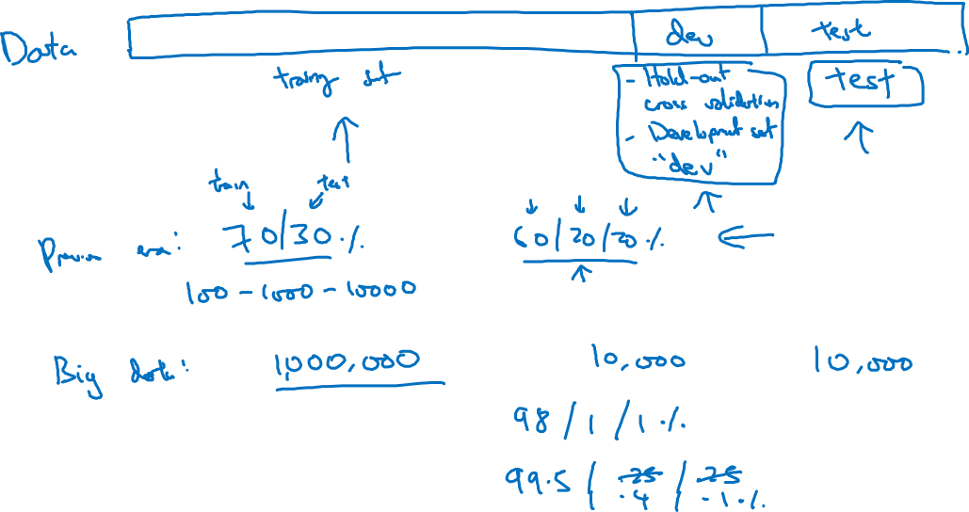
Train/dev/test sets

Slide 4
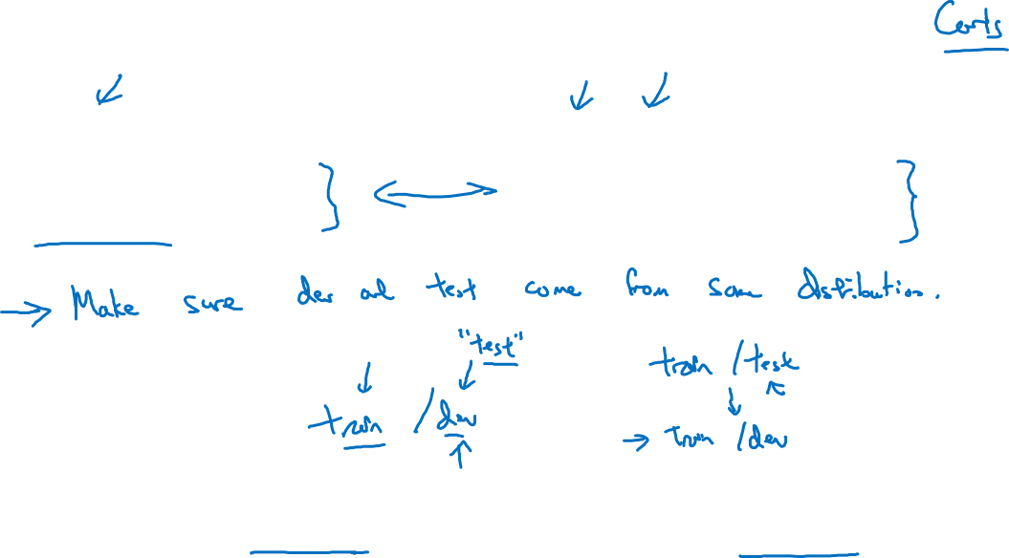
Mismatched train/test distribution
Training set:
Cat pictures from webpages
Dev/test sets:
Cat pictures from users using your app
Not having a test set might be okay. (Only dev set.)

Slide 5
Setting up your
ML application
Bias/Variance
deeplearning.ai

Slide 6
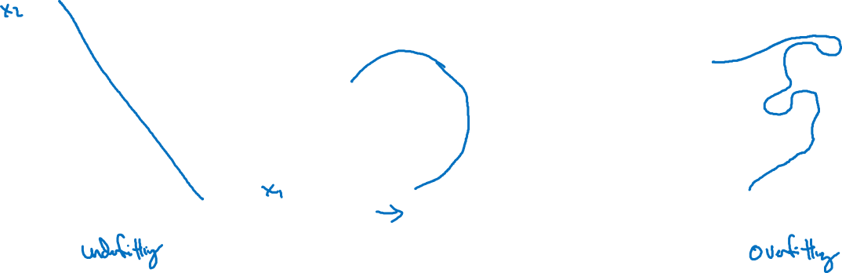
Bias and Variance
high bias
“just right”
high variance

Slide 7

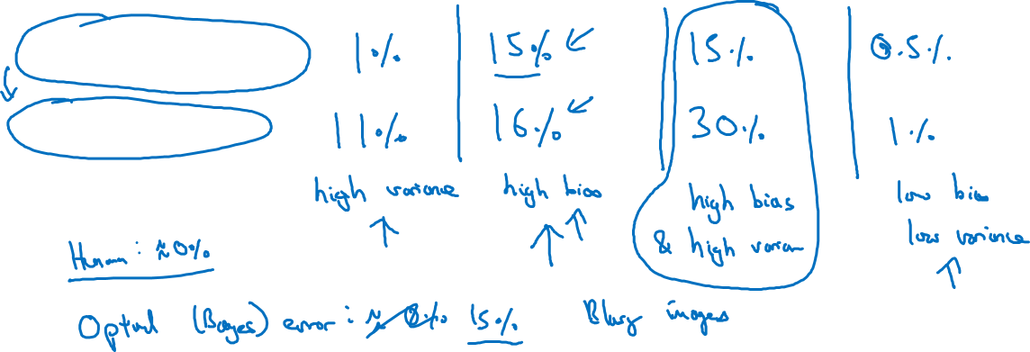
Bias and Variance
Cat classification
Train set error:
Dev set error:

Slide 8

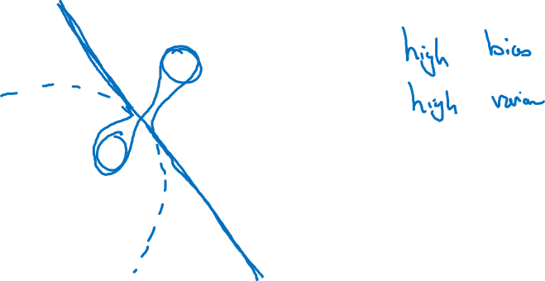

High bias and high variance

Slide 9
Setting up your
ML application
Basic “recipe”
for machine learning
deeplearning.ai

Slide 10
Basic “recipe” for machine learning

Slide 11
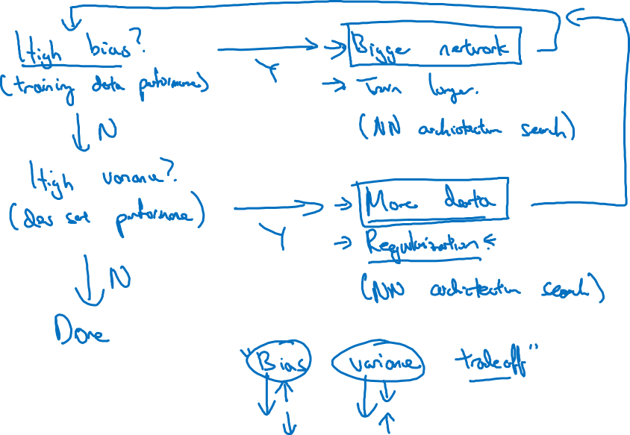
Basic recipe for machine learning

Slide 12

Setting up your ML application
Basic “recipe” for machine learning
deeplearning.ai

Slide 13
Basic “recipe” for machine learning

Slide 14
Basic recipe for machine learning

Slide 15
Basic recipe for machine learning

Slide 16
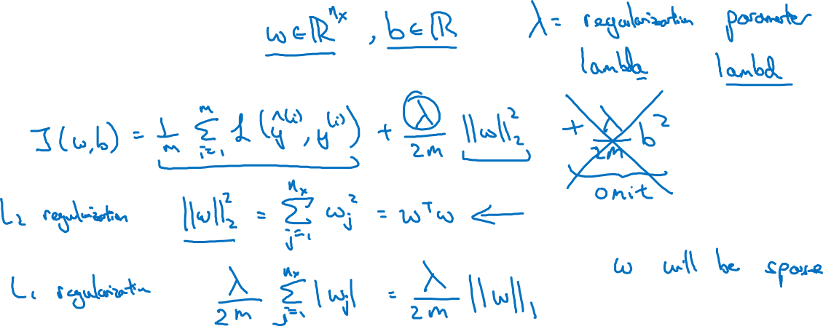
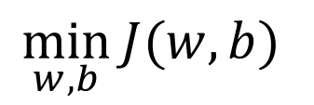
Logistic regression

Slide 17
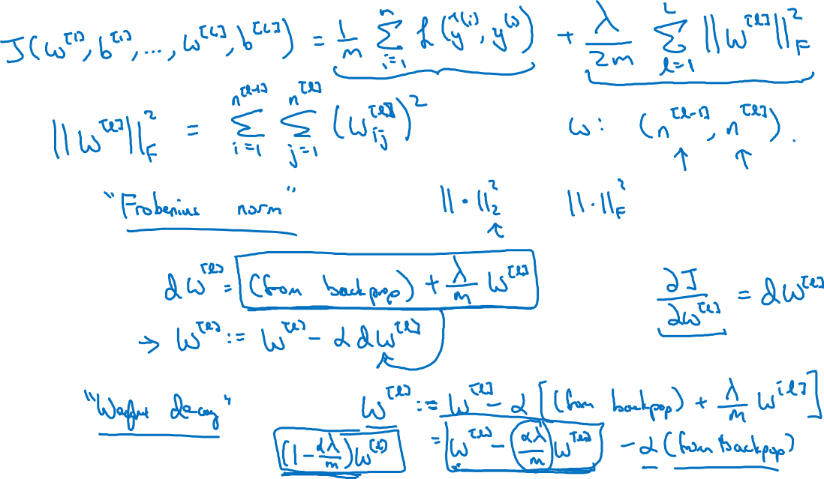
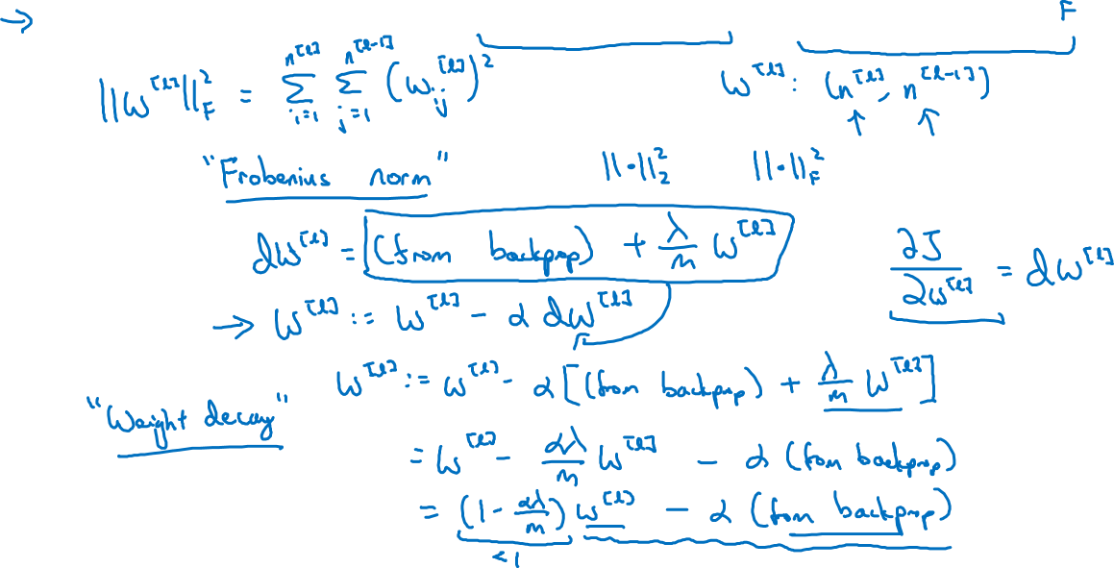
Neural network

Slide 18
Neural network

Slide 19




How does regularization prevent overfitting?

Slide 20
How does regularization prevent overfitting?

Slide 21
Regularizing your neural network
Why regularization reduces overfitting
deeplearning.ai

Slide 22
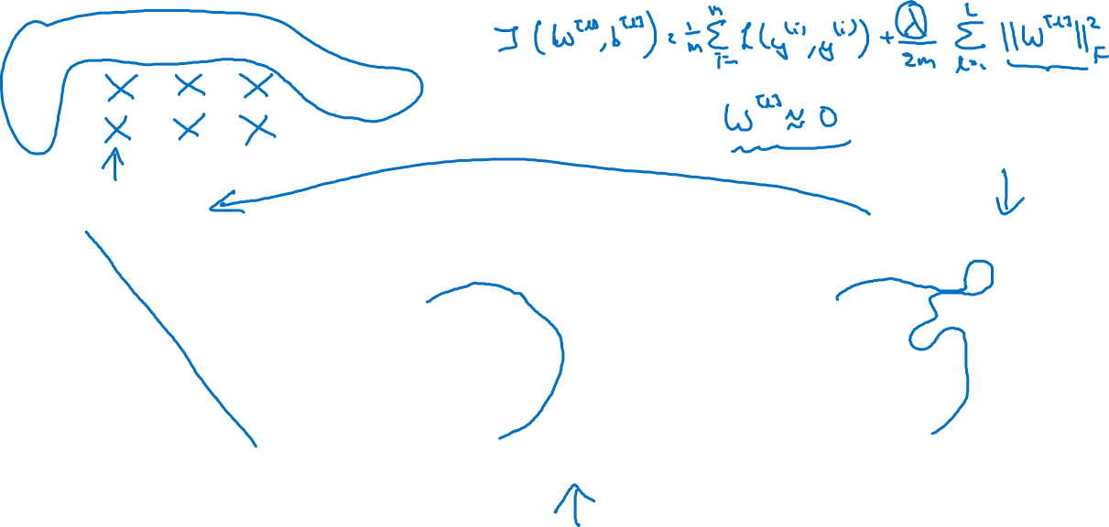
How does regularization prevent overfitting?
high bias
“just right”
high variance

Slide 23
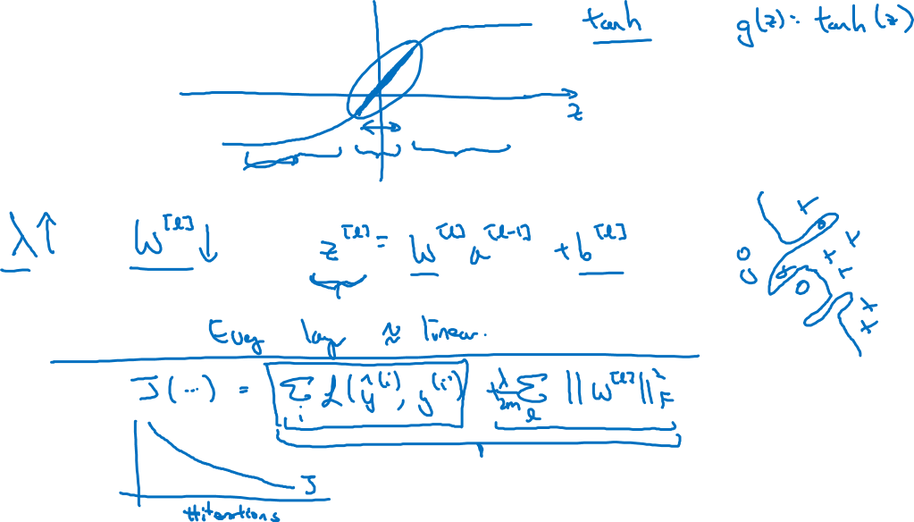
How does regularization prevent overfitting?

Slide 24
How does regularization prevent overfitting?

Slide 25
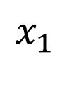
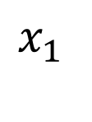
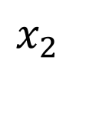
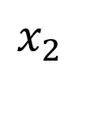


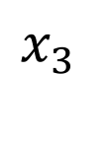
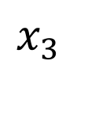
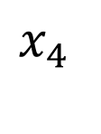
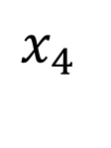

Dropout regularization

Slide 26
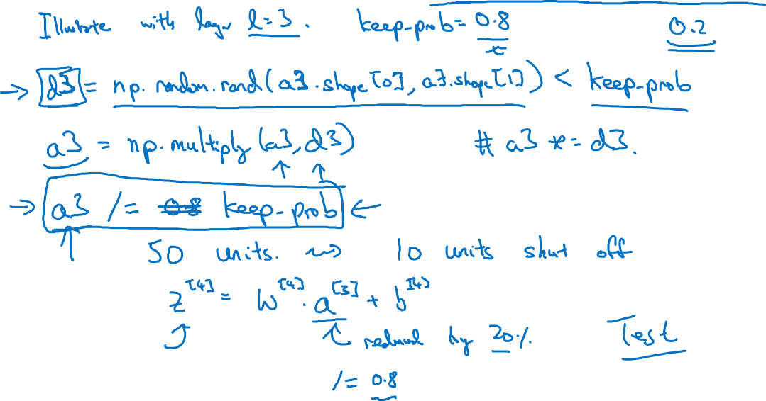
Implementing dropout (“Inverted dropout”)

Slide 27
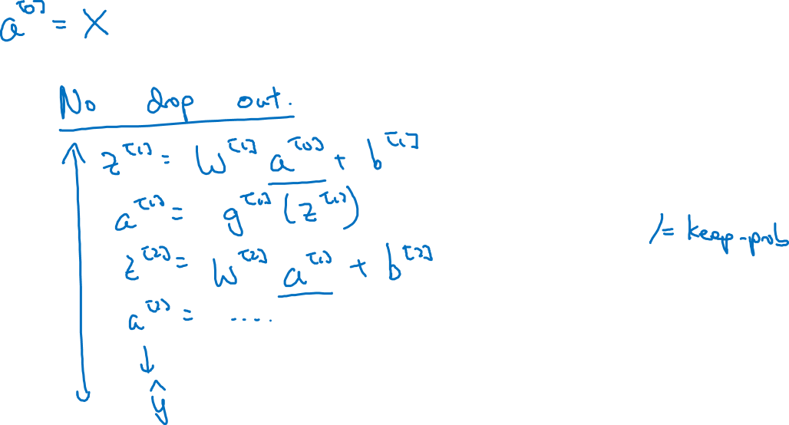
Making predictions at test time

Slide 28
Regularizing your neural network
Understanding
dropout
deeplearning.ai

Slide 29
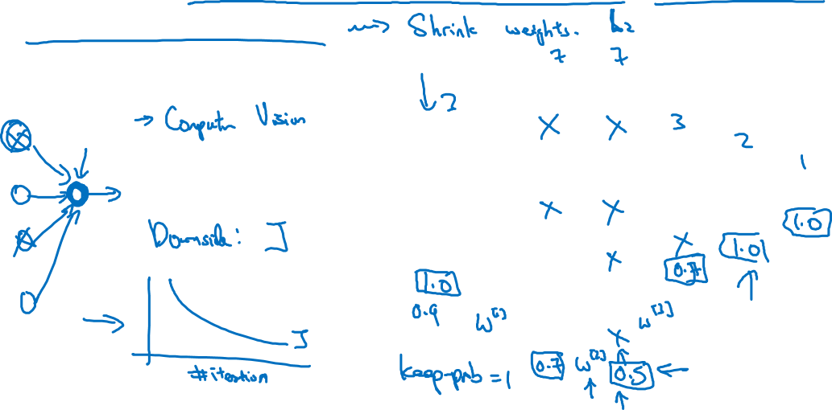
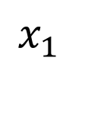
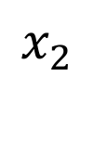

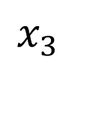
Why does drop-out work?
Intuition: Can’t rely on any one feature, so have to
spread out weights.

Slide 30
Regularizing your neural network
Dropout
regularization
deeplearning.ai

Slide 31
Dropout regularization

Slide 32
Implementing dropout (“Inverted dropout”)

Slide 33
Making predictions at test time

Slide 34
Regularizing your neural network
Understanding
dropout
deeplearning.ai

Slide 35
Why does drop-out work?
Intuition: Can’t rely on any one feature, so have to
spread out weights.

Slide 36
Regularizing your neural network
Other regularization
methods
deeplearning.ai

Slide 37


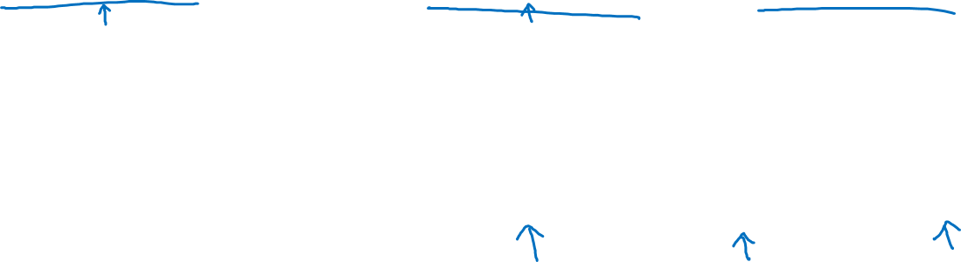

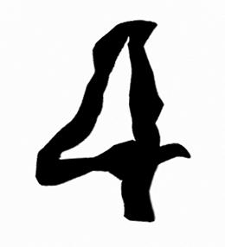
Data augmentation
4

Slide 38
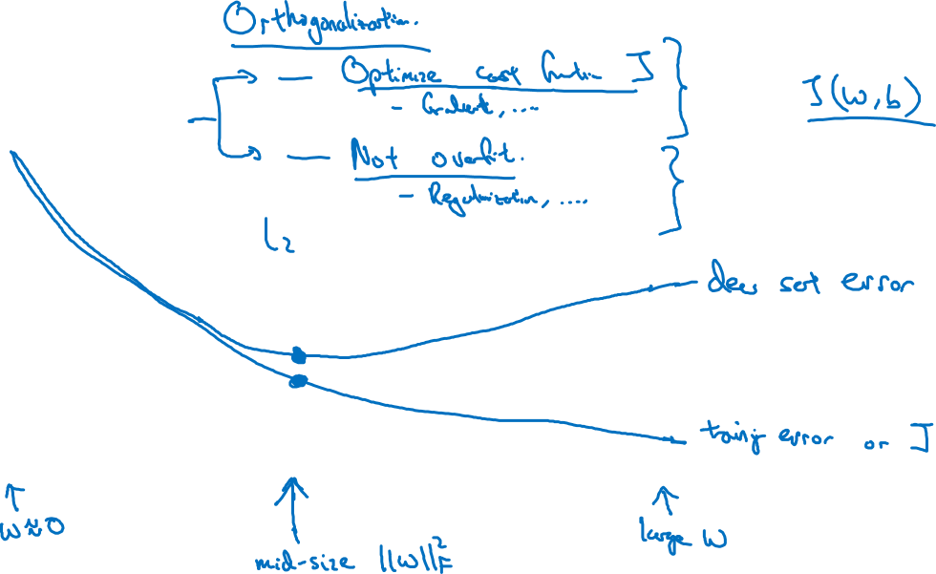
Early stopping
# iterations

Slide 39
Setting up your optimization problem
Normalizing inputs
deeplearning.ai

Slide 40
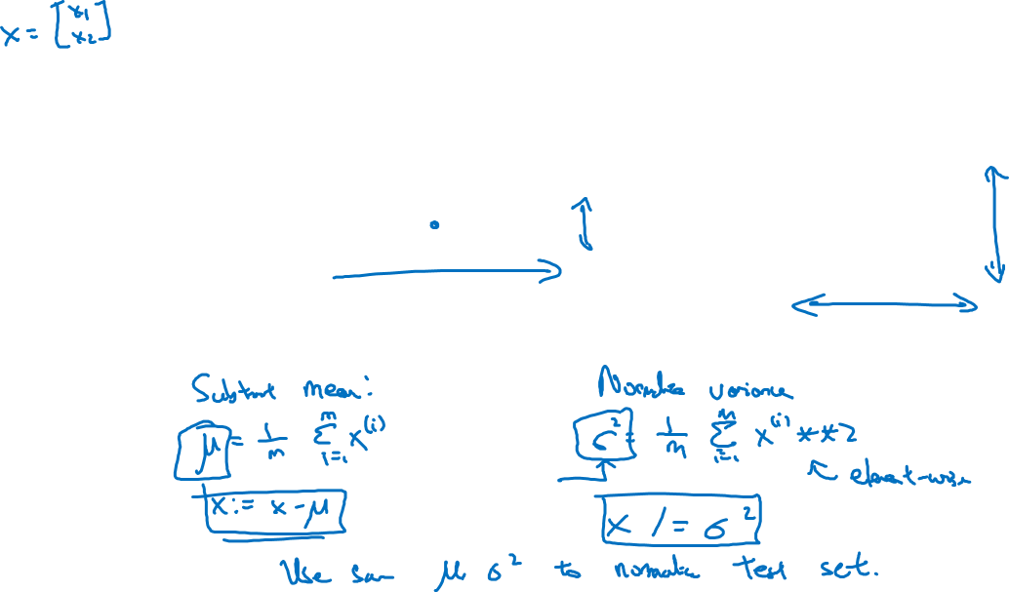








Normalizing training sets

Slide 41
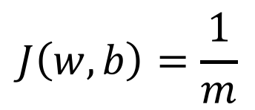
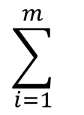

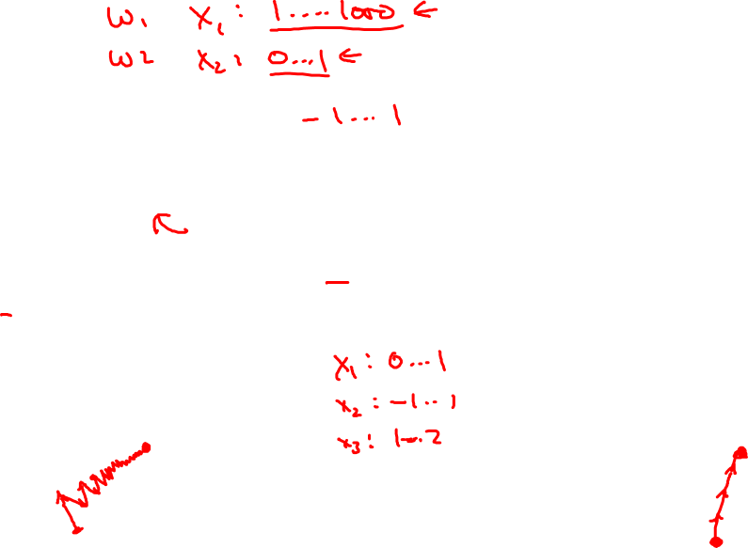


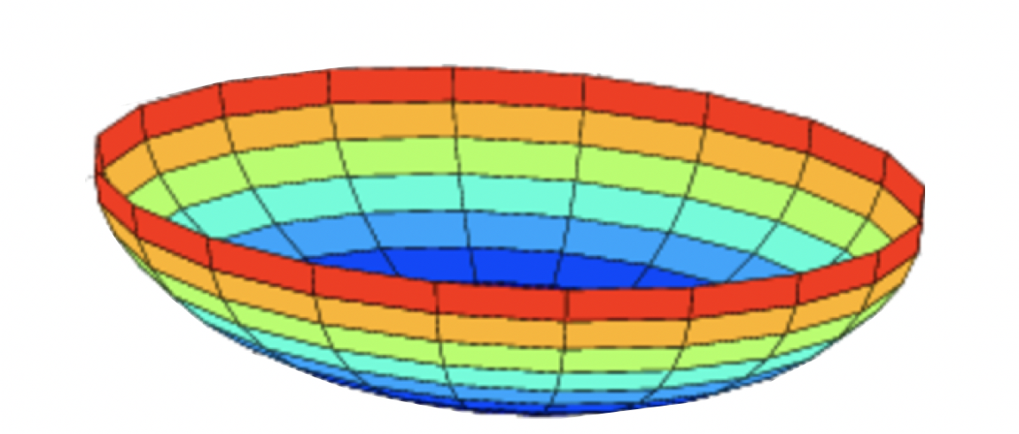









Why normalize inputs?
Unnormalized:
Normalized:

Slide 42
Setting up your optimization problem
Vanishing/exploding
gradients
deeplearning.ai

Slide 43
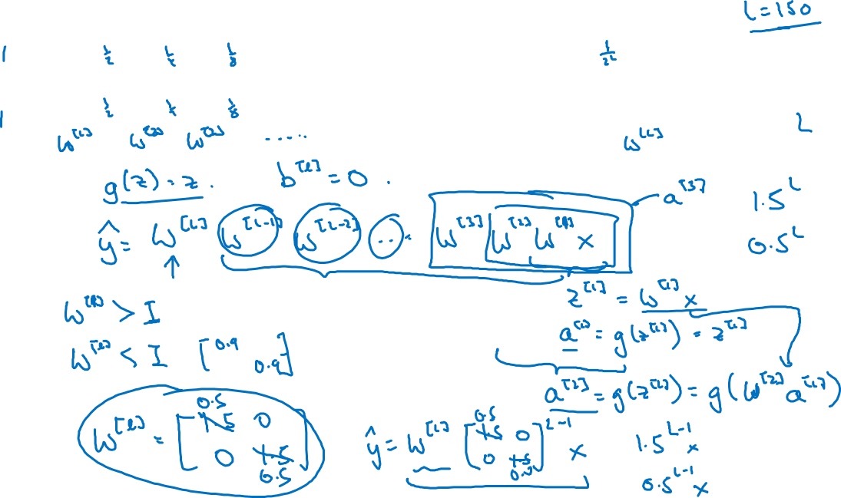



Vanishing/exploding gradients
=

Slide 44
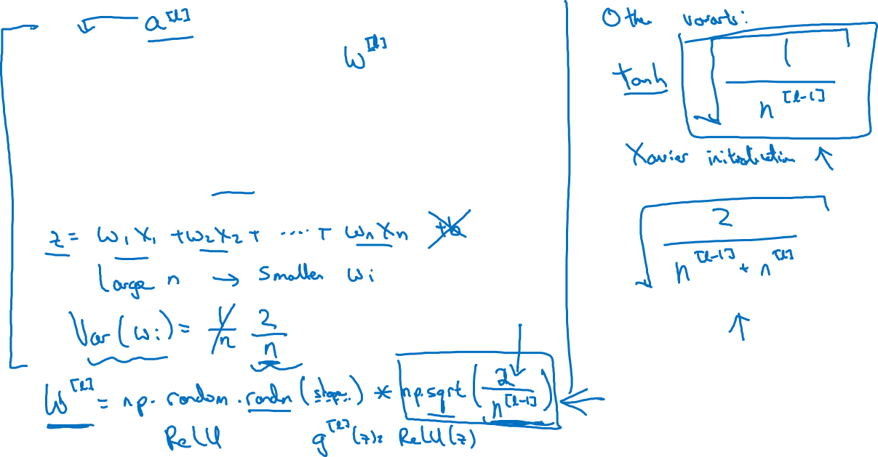






Single neuron example

Slide 45
Note: the font is smaller than usual here so it fits nicely.
Setting up your optimization problem
Numerical approximation
of gradients
deeplearning.ai

Slide 46
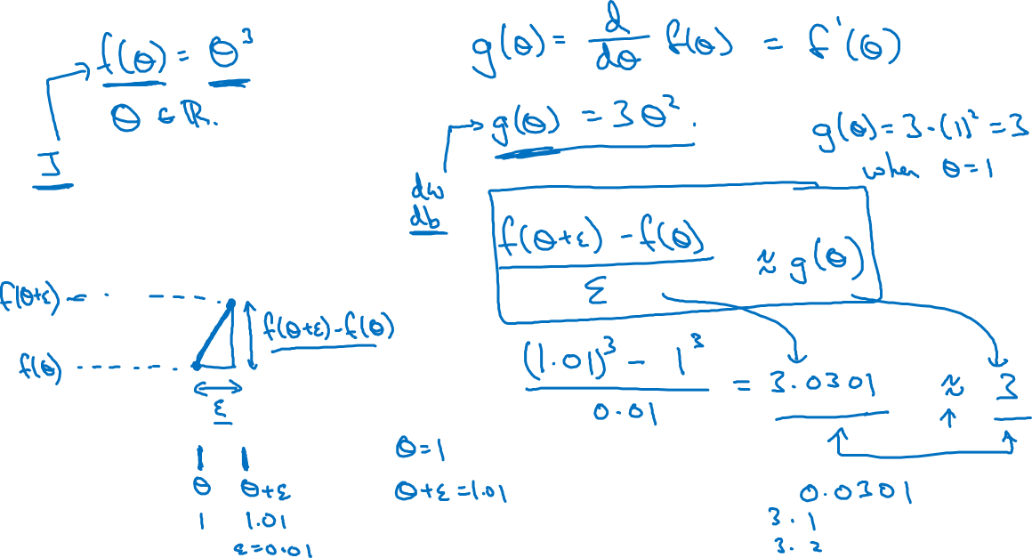

Checking your derivative computation

Slide 47
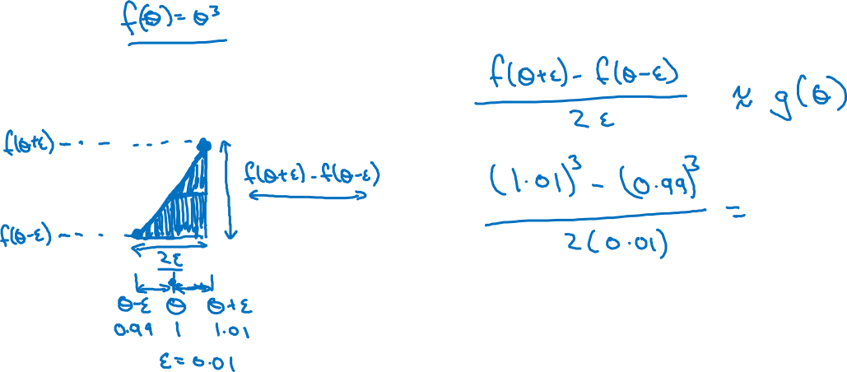
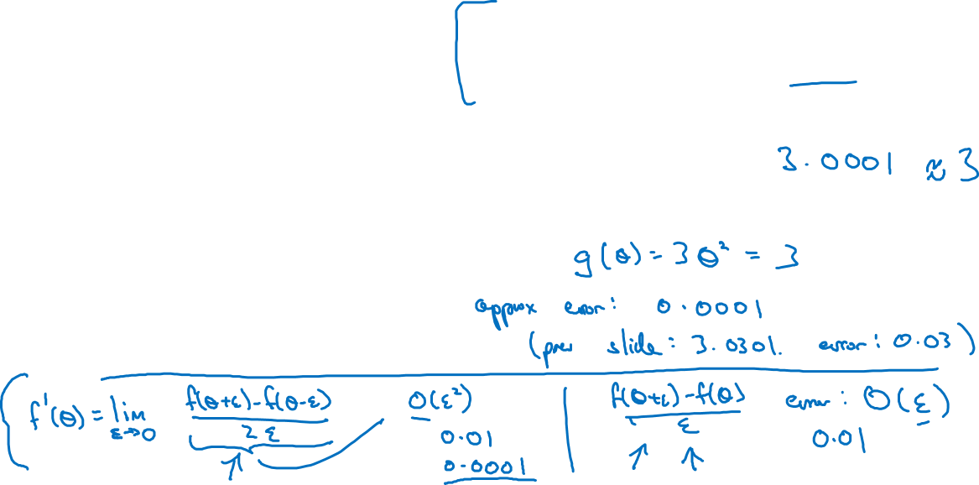
Checking your derivative computation

Slide 48
Setting up your optimization problem
Gradient Checking
deeplearning.ai

Slide 49
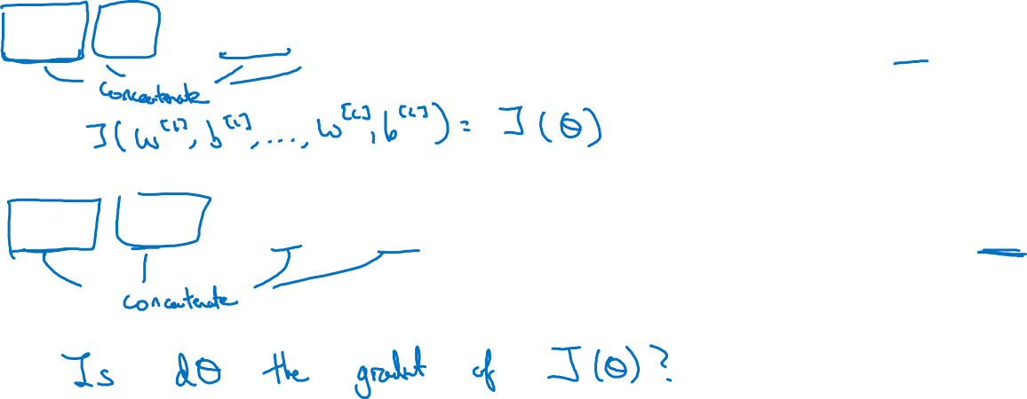
Gradient check for a neural network
Take and reshape into a big vector
Take and reshape into a big vector

Slide 50
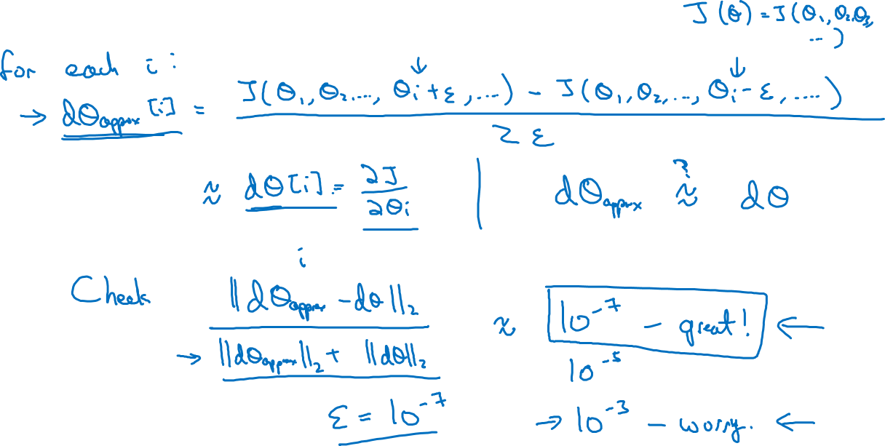
Gradient checking (Grad check)

Slide 51
Setting up your optimization problem
Gradient Checking
implementation notes
deeplearning.ai

Slide 52
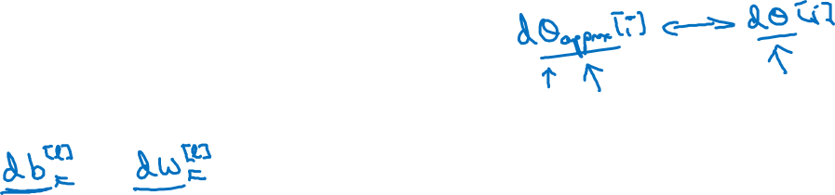
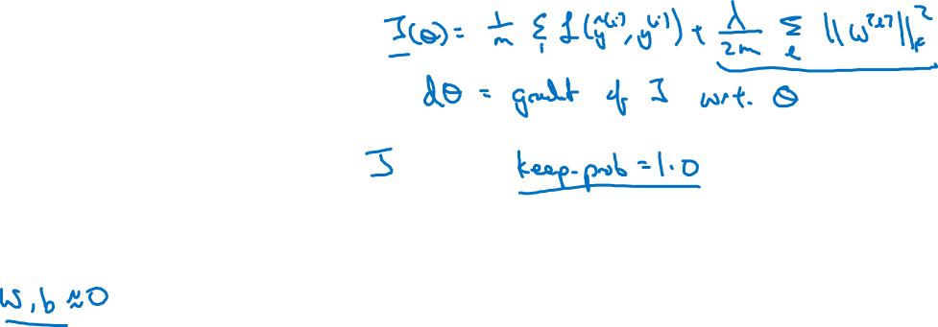
Gradient checking implementation notes
- Don’t use in training – only to debug
- If algorithm fails grad check, look at components to try to identify bug.
- Remember regularization.
- Doesn’t work with dropout.
- Run at random initialization; perhaps again after some training.

